Slide 1
INSTRUCTIONS
Use Font size 22 to 28 and Font Style Times New Roman (body)
Do not change the Template: Heading / Title of the slides
Do not change font style or colours
Do not copy paste paragraphs: use only Bullet Points
Maximum slide Limit is 20 only
As per the number of supervisor allotted adopt slide-2 or slide-3
Please display the required meaningful Content or images or tables
Change the footer accordingly using insert tab then click on header & footer tab and edit it
Save the PPT with Register No, Dept and Review no, example: 23xxxxxxxxx_CSE

Slide 2

Title: Pharma Inventory Billing Management System
Student Name: K.Swathi Sree
Student ID: 2520030410 Cluster:4
Section: 14
Under the Guidance
of
Supervisor Name:Dr.K.Sree Rama Murthy
Assistant Professor
Department of CSE

Slide 3
OUTLINE
Abstract
Existing System
Proposed System
System Architecture
Project Modules
Objectives
Co’s Attainments - FWD
Co1
Co2 …….. 5. Co5
Co’s Attainments - DSA
Co1
Co2 …….. 5. Co5
Screen Shots for FWD & DSA
Conclusion
Geo-Tagged Photos

Slide 4
Abstract
Demonstrates the application of Data Structures and Algorithms in a Pharma Inventory & Billing System.
Uses algorithms such as Searching and Sorting for efficient data management.
Implements List ADT for structured data organization.
Utilizes Linked Lists including Singly, Doubly, and Circular Linked Lists.
Applies Stack for arithmetic expression evaluation and balancing symbols in billing.
Uses Queue, Circular Queue, and Dequeue to manage customer billing flow and order processing.
Implements Hashing for fast medicine lookup in the inventory.
Uses Priority Queue (Binary Heap) to handle near-expiry medicines efficiently.

Slide 5
Existing System
Most medical stores use manual record keeping for inventory and billing.
Medicine stock details are maintained in registers or basic spreadsheets.
Tracking expiry dates manually is difficult and time-consuming.
Searching for medicine details takes more time due to lack of automated systems.
Billing calculations are done manually, which may lead to errors.
No efficient system to prioritize near-expiry medicines.
Difficult to manage large amounts of medicine data.
Lack of efficient searching and sorting mechanisms.

Slide 6
Proposed System
Develop an automated Pharma Inventory & Billing System using Data Structures and Algorithms.
Maintain digital records of medicines, stock, and expiry dates for easy management.
Use searching algorithms to quickly find medicine details.
Apply sorting algorithms to organize medicines by price and expiry date.
Implement Linked Lists for efficient storage and management of medicine data.
Use Stacks for expression evaluation and billing calculations.
Apply Queues and Circular Queues to manage customer billing flow.

Slide 7
System Architecture
The system is designed with multiple modules to manage pharmacy inventory and billing efficiently.
User Interface Module allows the user to enter medicine details, billing information, and search queries.
Inventory Management Module stores and updates medicine stock, price, and expiry date details.
Data Structures Module implements structures like Linked Lists, Stacks, Queues, Hash Tables, and Priority Queues for efficient data handling.
Searching Module retrieves medicine information quickly using efficient searching algorithms.
Sorting Module organizes medicines based on price, expiry date, or name.

Slide 8
Project Modules
User Interface Module – Allows users to interact with the system, enter medicine details, search medicines, and generate bills.
Inventory Management Module – Manages medicine stock, price, quantity, and expiry date information.
Searching Module – Uses searching algorithms to quickly find medicine details by ID or name.
Sorting Module – Organizes medicines based on price or expiry date using sorting algorithms.
Billing Module – Generates customer bills and performs price calculations for purchased medicines.
Stack Module – Used for expression evaluation and balancing symbols during billing operations.
Queue Module – Manages customer billing flow using Queue and Circular Queue.

Slide 9
Objectives
To design and develop a Pharma Inventory & Billing System using Data Structures and Algorithms.
To efficiently manage medicine stock, price, and expiry dates.
To implement searching algorithms for quick retrieval of medicine information.
To apply sorting algorithms to organize medicines by price and expiry date.
To use Linked Lists for efficient storage and management of medicine records.
To implement Stacks and Queues for handling billing operations and customer flow.
To use Hashing techniques for fast lookup of medicines in the inventory.

Slide 10
Co’s Attainments - FWD
CO-1: Implemented Searching algorithms using Linear Search to find medicines by ID and Sorting concepts for organizing medicine data like price and expiry date.
CO-2: Designed and implemented Abstract Data Types using Linked Lists. A Singly Linked List is used to store and manage medicine inventory (add and display medicines).
CO-3: Applied Stack concepts for arithmetic expression evaluation in billing operations and Queue concepts for managing customer billing flow.

Slide 11
Co’s Attainments - FWD
CO-4: Implemented Priority Queue (Binary Heap) to efficiently process near-expiry medicines first based on expiry days.
CO-5: Developed a practical application of Data Structures for managing pharmacy inventory, medicine details, and billing operations.
CO-6: Built a Java-based application using Data Structures concepts, demonstrating real-world implementation of algorithms and data structures in a pharmacy management system.

Slide 12
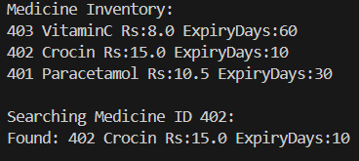
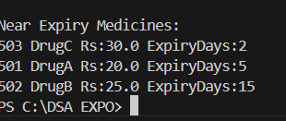
Screenshots for FWD & DSA

Slide 13
Conclusion
The Pharma Inventory & Billing System demonstrates the practical application of Data Structures and Algorithms in a real-world pharmacy scenario.
The system efficiently manages medicine inventory, expiry dates, and billing operations.
Different data structures like Linked Lists, Stacks, Queues, Hash Tables, and Priority Queues improve data management and processing speed.
Searching and sorting algorithms help retrieve and organize medicine data quickly.
The implementation improves accuracy, efficiency, and speed compared to manual systems.
Overall, the project shows how Data Structures can be used to develop efficient and scalable applications.

Slide 14
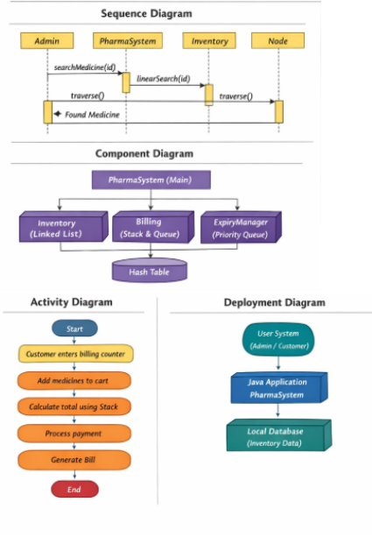
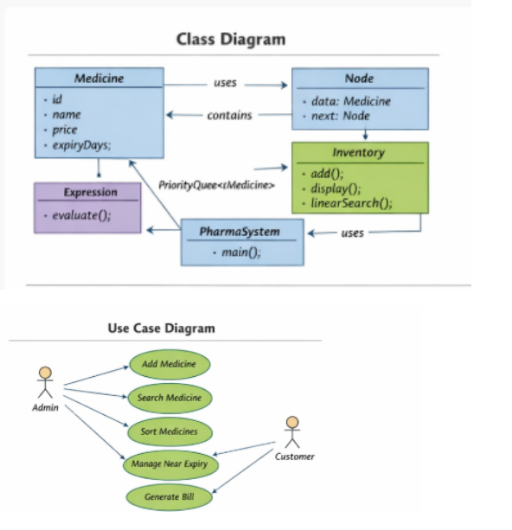
Class Diagrams:

Slide 15
THANK YOU

